Slide 1

Construction Marketing Services, LLC
Full Media Marketing Specialists For Construction Equipment Distributors, General Civil Engineering Contractors and a Long List of Other Construction Service Providers

Slide 2
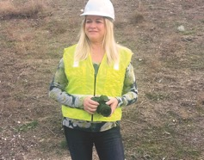
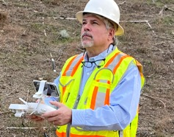

MEET THE TEAM
Kerry Hoover
Owner/Publisher
Brian Hoover
Owner/Senior Editor
Aldo Myftari
Art Director
Your Marketing Team With 80 Years Combined Experience In The Industry

Slide 3
CMS Media product offerings
Construction Publications
  CalContractor Magazine
  California Asphalt Magazine
  The Conveyor Magazine
Social Media Services
  Design & Launching Services for Instagram, LinkedIn, YouTube & Facebook
Advertising Specialties
  ASI Member
  Guaranteed Best Prices
  Free Design Services
From The Tailgate Interviews
  YouTube Channel
  Jobsite Interviews
  Company Profiles
  New Product Announcements
E-Mail Blast Services
  Free New Product News
  Custom Design E-Mail Blasts
  Digital Magazine E-Mail Blast
  Weekly Newsletter & Video News E-Mail Blast
Drone & Photography Services
  Part 107 FAA Certified
  Full Video Production Services
  Still Photography Services

Slide 4



Construction Publications
  CalContractor Magazine
  California Asphalt Magazine
  The Conveyor Magazine
Contact Kerry Hoover for more information:
909-772-3121
khoover@calcontractor.com
Published 12 times each year and distributed to thousands of general engineering contractor throughout California. CalContractor features local editorial with contractor profiles, job stories and local industry news.
Bimonthly magazine distributed to members of the California Asphalt Association, contractors, construction material producers and federal state and local government officials.
Quarterly magazine distributed to members of the California Construction Industrial Materials Association, contractors, material producers and government officials.

Slide 5





Social Media Services
  Design & Launching Services for Instagram, Linkedin, YouTube & Facebook
  Build Your Brand
  Connect with Customers
  Promote Products & Services
  Convert Visitors to Customers

Slide 6
E-Mail Blast Services
  Free New Product News
  Custom Design E-Mail Blasts
  Digital Magazine E-Mail Blasts
  Weekly Newsletter & Video News E-Mail Blasts

Slide 7

From The Tailgate Interviews
  YouTube Channel
  Jobsite Interviews
  Company Profiles
  New Product Announcements

Slide 8
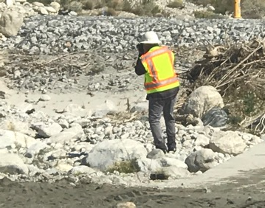
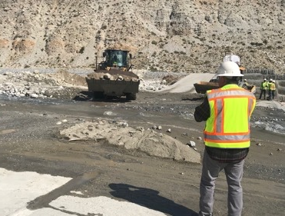
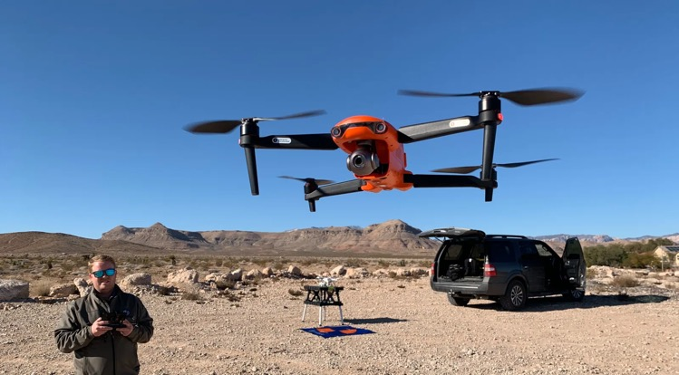
Drone & Photography Services
  Part 107 FAA Certified
  Job Story Drone Services
  Full Video Production Services
  Still Photography Services

Slide 9







Advertising Specialties
  ASI Member
  Guaranteed Best Prices
  Free Design Services

Slide 10
Construction Marketing Services, LLC
Call Kerry Hoover for a free consultation to see what Construction Marketing Services can do for your business.
909-772-3121 or email
khoover@calcontractor.com
Click here for 2024 rate sheets and editorial calendars

